Slide 1
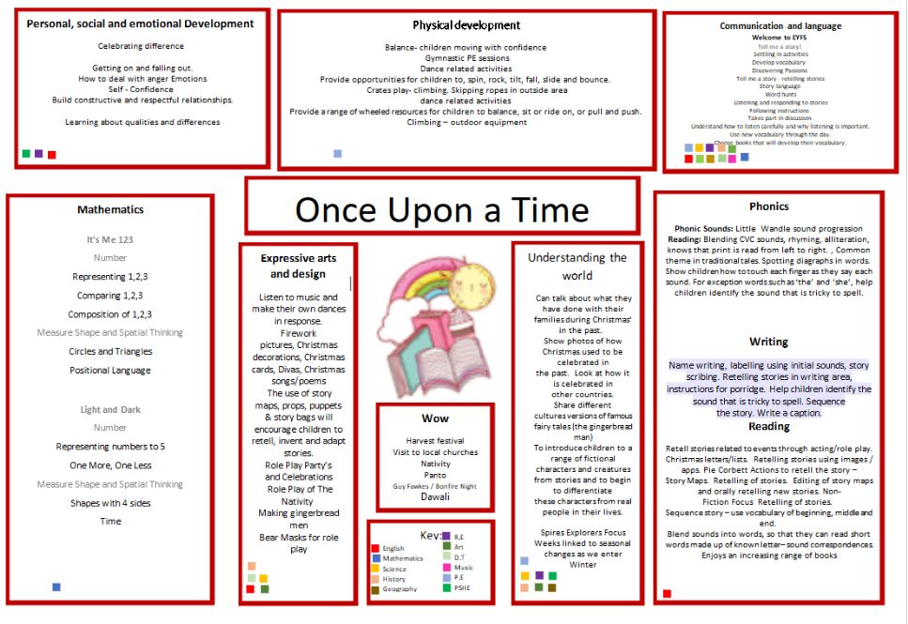

Slide 2
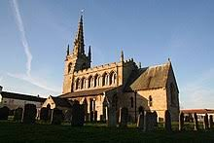

Writing We will continue to secure our grammar and punctuation knowledge, as we start to look at different text types in readiness for our feature spotting. | Reading We will continue to follow the Little Wandle scheme for our Guided Reading sessions. We will also focus on a chapter book as part of our whole-class guided reading, answering lots of different questions. | Maths In both years we are looking at place value before ending our term on the topic of 'shape. | Science In Science we will look at seasonal change for our transition into winter. We will then focus on the topic of animals including humans.
History We are looking at our local area this term. We will be looking back at the old village and how it has changed over time. Then we will be looking further to Lincoln and the history of our great city. | Pixies –Year 1/2 Autumn 2- On Our Doorstep |  | Religious Education We will focus on what Christians believe God is like.
Computing This unit introduces our pupils to digital painting. We will be creating pieces of digital art and comparing these to real life paintings, sharing our views. |  |  | Music In our music lessons we will develop our skills in pulse, rhythm and pitch..
 | PE In PE with our coach we will be focusing on our dribbling skills and in our secondary lesson we will be focusing on dance. | DT In DT we will focusing on structures, we will be creating a chair considering which materials would be best and reviewing our designs. | Personal, Social & Health Education Our focus is celebrating difference where we will be discussing similarities and differences in our classroom and the wider world. We will be celebrating what makes us unique.

Slide 3
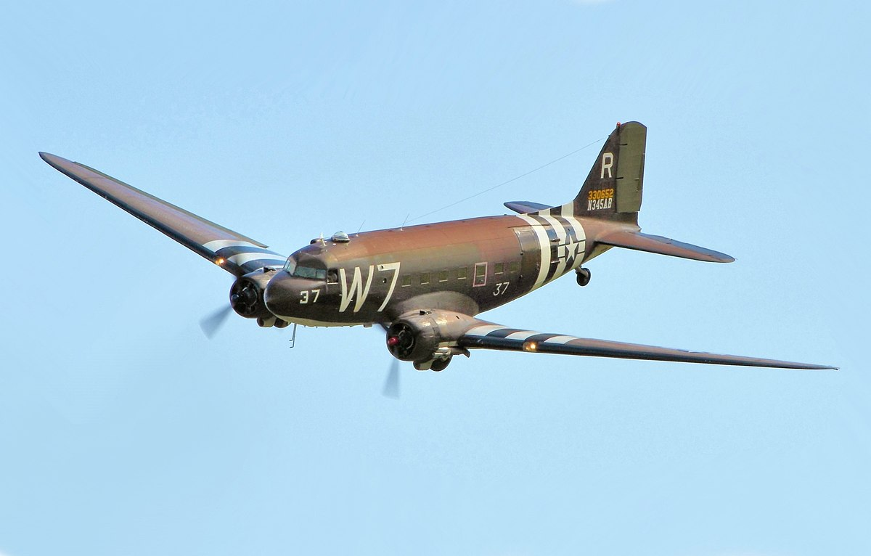
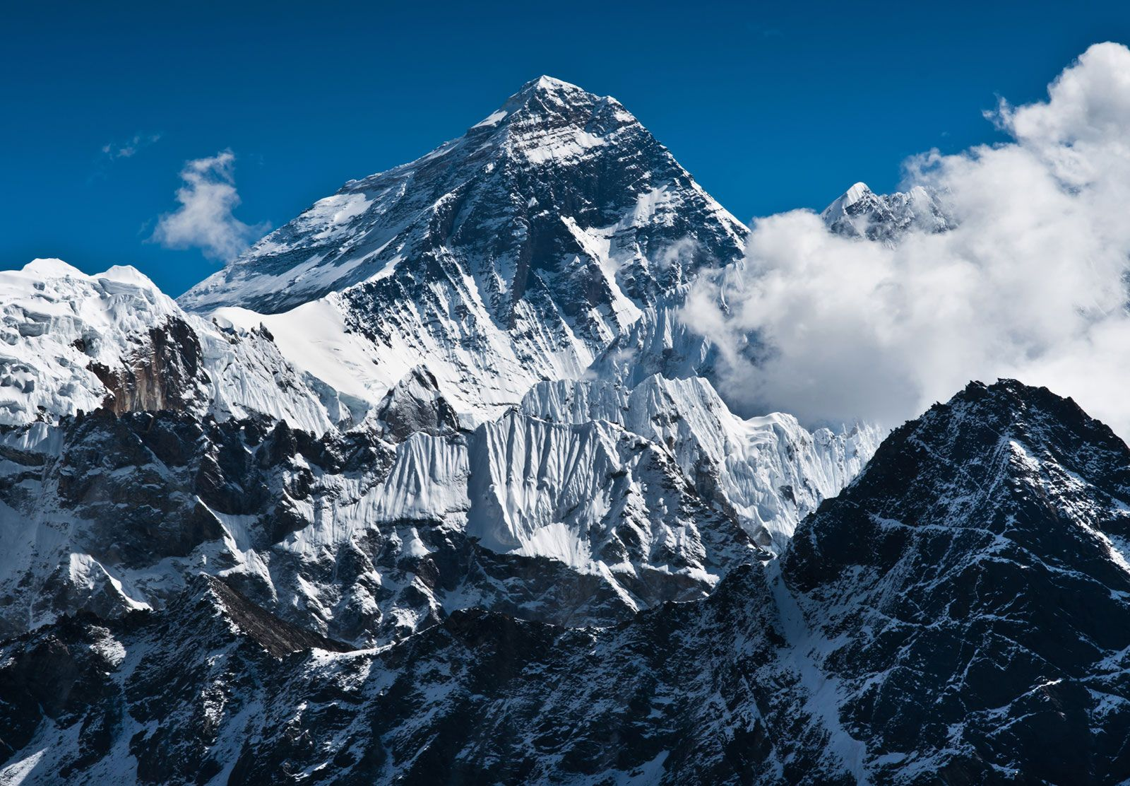
Writing This term we will be using our new WW2 topic to inspire our writing. We will be looking closely at both diary and letter writing and plan to write in role as a child evacuated from the city during the war. | Reading Our whole class book study sessions will use the text 'The lion and the unicorn' to help us answer questions based on vocabulary, summarising, inference and prediction. We will also look at a range of different texts each week following the Ashley Booth scheme. | Maths Our new mixed age planning continues to look at addition and subtraction this term before moving on to our first topic on multiplication and division. | Science .In science this term we will be learning all about how sound is made as well as the parts of the ear. We will be investigating pitch and volume.
History This term we begin our World War 2 topic exploring key events and how Britain became involved. We will also focus on how the lives of people during the war changed dramatically through evacuation, rationing, roles of women etc. | Gnomes – Year 3/4 Autumn 2 - WW2 |  | Religious Education What does it mean to be a Hindu in Britain today? In this unit we will continue to learn about Hindu Dhama, Hindu places of worship, Hindu festivals, we will learn about the different characters in Hindu stories before looking at what makes a good Hindu thinking about dharma and karma.
Computing We will be looking at how to use the computer systems and networks at school and understand how digital devices can help us. |  |  | Music In this unit, we ask, ‘What Stories Does Music Tell Us About the Past?’. The Social Question evolves as the children move through the scheme while encouraging them to be responsible and kind citizens of the world. During this unit the children will sing, improvise, compose, perform, listen and respond as well as learn about the different elements of music.
French In French we will be working on our conversational vocabulary to be able to talk about the four different seasons. | PE During our coach led PE sessions we will be developing our netball skills. We also have swimming to look forward to as our second PE session this term. | Art and DT Our DT this term will be looking at structures. The children will explore making their own structures for different purposes ensuring they are strong, stable and aesthetically pleasing. The children will explore a range of materials and techniques. | Personal, Social & Health Education We will be discussing and asking questions around 'celebrating differences.' We will understand that being different is a fantastic thing and that we should have mutual respect for people who are different to ourselves.

Slide 4
Writing We will start to use WW2 as inspiration for our writing. We will hopefully write diaries and letters from the perspective of people who were on the front line or those that had been evacuated to the countryside. We will hopefully conclude the term with some Christmas Poetry. | Reading We will read a variety of texts where we answer a range of questions which enables us to critically think and analyse the text: these texts can be found on blogs with resources by Ashley Booth via the internet. We will also have a class book which we will read throughout the term; inspired by our theme of WW2, this will be 'Once' by Morris Gleitzman. | Maths Year 5 and 6 children will be learning the same content throughout this term, we will spend the first half looking at fractions before looking at multiplication and division before Christmas. | Personal, Social & Health Education We will be discussing and asking questions around 'celebrating differences.' We will understand that being different is a fantastic thing and that we should have mutual respect for people who are different to ourselves.
Geography/History This term in History we will be learning about WW2 and understanding how it has affected us. We have already been to Metheringham Airfield and understood the role of the RAF in our local area during the war. | Imps – Year 5/6 WWII |  | Religious Education We will learn about whether you need to believe in God to be good. We will look at this question from the perspective of different religions. We will learn about how humanists and non-religious people find purpose in their lives as well.
 |  |  | Music We will continue playing the steel pans and learn some new songs. We hope to learn more musical terminology like harmonies and melodies and how we can utilise this knowledge in our own compositions.
Computing In computing, we will be creating media. This will be in the form of video production. We will storyboard, write scripts, film and then edit our own mini films. (We might even host our own little film festival).
 | PE In PE with Mr Margarson, children will be learning about Netball and with Premier Education, the children will be doing dance. | Art and DT We will be looking at textiles in our DT work; we will be designing and creating our own waistcoats. We will be practising different techniques and stitches that we were introduced to when designing our Egyptian collars. | Science In science, we will be learning about evolution and inheritance. We will understand how we gain features from our parents and how adaptation differs from evolution. We will also understand how all living things, including plants, evolve.
French In French, we will be learning about 'Do you have a pet?'. This will include looking at the vocabulary of different animals. There will be opportunities for conversation within our work.

