Slide 1

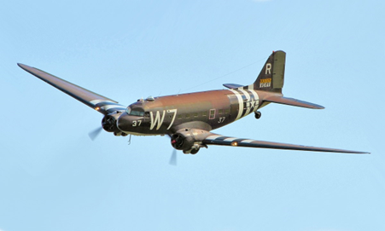
Writing In English, we will be continuing to write a setting description linked to WWII. We will also be looking at writing letters. Our narrative writing will continue with a focus on characterising speech. | Reading During guided reading sessions, we will encounter a wide variety of texts, answering questions which focus on retrieval, inference, prediction, vocabulary, summarising and explanation. We will also study a class novel on a Monday which is Blackout by Tony Bradman. | Maths In maths, we will continue to work on fractions before looking at long multiplication and division. We will practice multiplying and dividing fractions. Through a range of activities, we will build our confidence in applying these concepts to solve problems and deepen our mathematical understanding. | Science In Science, we will be finishing off our topic on evolution before exploring the topic of forces. We will investigate how forces such as gravity, friction, and air resistance affect objects, conducting experiments to understand their effects in real-world contexts.
Geography/History In History, we will continue learning about World War II, with a focus on how the war impacted Britain. We will explore key events, changes in daily life, and the experiences of people living in Britain during the war. | Class 2 – Years 5/6 Spring 1 |  | Religious Education In RE, we will explore the relationship between religion and science, discussing whether they complement each other or cause conflict. Through thoughtful discussions, we will consider different perspectives and develop our understanding of this complex topic.
 |  |  | Music In this unit, we will be learning about singing and playing in different styles. We will listen to a ramge of musical styles, sing , improvise, compose and play glockenspiels with the new songs that we have learnt.
Computing In Computing, we will learn about selection in physical programming. This involves using conditions to control the flow of programs. We will hopefully be using Crumbles to create and test our own programs, applying our knowledge of selection in a hands-on way.
French In French, we will be learning vocabulary and phrases related to 'my home.' We will practice describing different rooms, furniture, and activities, enhancing our speaking, listening, and writing skills. | PE Premier Education will be delivering one of our PE sessions each week, and this term we will be looking at invasion games, with a focus on pop lacrosse. As part of PE with Mrs Walker we will be looking at Tennis as part of net and wall games. | Art We will be learning about a range of sculpture artists as well as looking at the skills required to make our own sculptures. | Personal, Social & Health Education Our focus this term is 'Dreams and Goals'. We will reflect on our aspirations, set personal targets, and discuss the steps needed to achieve them, fostering resilience and a positive mindset.

