Slide 1
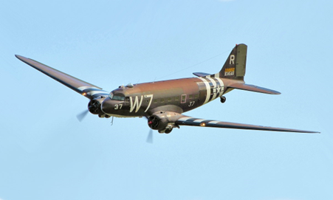

Writing In English, we will be continuing to write a setting description linked to WWII. We will also be looking at writing letters. Our narrative writing will continue with a focus on characterising speech. | Reading During guided reading sessions, we will encounter a wide variety of texts, answering questions which focus on retrieval, inference, prediction, vocabulary, summarising and explanation. We will also study a class novel on a Monday which is Blackout by Tony Bradman. | Maths In maths, we will be looking at area before learning methods of multiplication and division, including written methods. We will continue to work on a variety of fluency, problem solving and reasoning questions. | Science We will start the term by finishing off our work on sound before beginning a new topic looking at rocks. We will look at how different rocks are formed including fossils and how the different rocks on earth can be classified.
Geography/History In History, we will continue learning about World War II, with a focus on how the war impacted Britain. We will explore key events, changes in daily life, and the experiences of people living in Britain during the war. | Class 2 – Years 3/4 Spring 1 |  | Religious Education In RE, we will explore the relationship between religion and science, discussing whether they complement each other or cause conflict. Through thoughtful discussions, we will consider different perspectives and develop our understanding of this complex topic.
 |  |  | Music In this unit, we will be learning about singing and playing in different styles. We will listen to a ramge of musical styles, sing , improvise, compose and play glockenspiels with the new songs that we have learnt.
Computing In computing this term, we will be focusing on programming using Scratch. We will learn how to order and sequence our sprites and look at how to adding sounds.
French In French this term, we will learn the names of common vegetables. We will also learn the basic language required take part in a role-play activity based on buying different quantities of vegetables from a market stall. | PE Premier Education will be delivering one of our PE sessions each week, and this term we will be looking at invasion games, with a focus on pop lacrosse. As part of PE with Mrs Walker we will be looking at Tennis as part of net and wall games. | Art We will be learning about a range of sculpture artists as well as looking at the skills required to make our own sculptures. | Personal, Social & Health Education Our focus this term is 'Dreams and Goals'. We will be thinking about our own dreams and ambitions, and learning how to face new challenges in the best way to allow us to achieve our goals.

