Slide 1

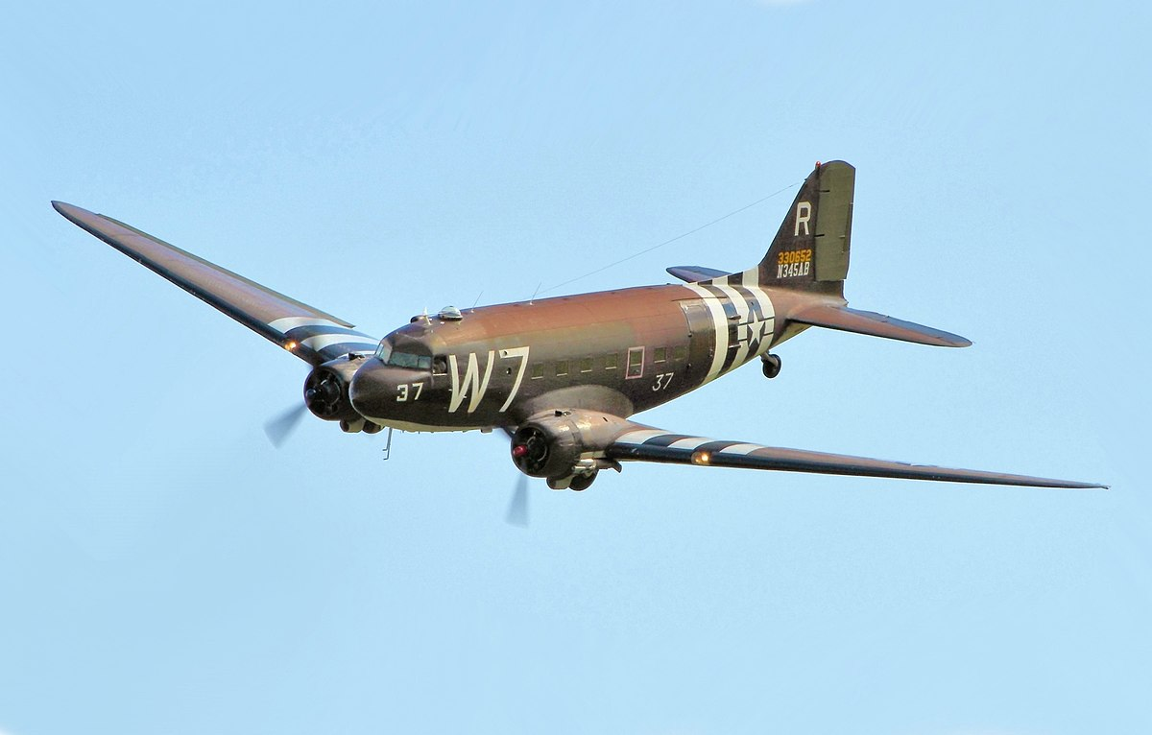
Writing In English, we will be writing poetry designed to entertain, based on the poem The Dreadful Menace. Following this, we will be writing setting descriptions linked to our topic on WWII and then looking at writing letters. | Reading During guided reading sessions, we will encounter a wide variety of texts, answering questions which focus on retrieval, inference, prediction, vocabulary, summarising and explanation. We will also study a class novel on a Monday which is a Michael Morpurgo book called Friend or Foe. | Maths In maths, we will begin by looking at multiplication and division followed by fractions. We will work on a variety of fluency, problem solving and reasoning questions. | Science In science, we will be learning about evolution and inheritance. We will understand how we gain features from our parents and how adaptation differs from evolution. We will also understand how all living things, including plants, evolve.
Geography/History This term in history, we will be learning all about World War II, beginning with a trip to Metheringham Airfield. We will be looking at how the war began and the impact that it had on Lincolnshire. | Panthers – Years 5/6 Autumn 2 World War II |  | Religious Education We will learn about whether you need to believe in God to be good. We will look at this question from the perspective of different religions. We will learn about how humanists and non-religious people find purpose in their lives as well.
 |  |  | Music In this unit, we ask, ‘How Does Music Connect Us with Our Past?’. The Social Question evolves as the children move through the scheme while encouraging them to be responsible and kind citizens of the world. We will be singing, improvising, composing and performing throughout the unit.
Computing In computing, we will be creating media. This will be in the form of video production. We will storyboard, write scripts, film and then edit our own mini films. (We might even host our own little film festival).
French In French, we will be learning about 'Do you have a pet?'. This will include looking at the vocabulary of different animals. There will be opportunities for conversation within our work. | PE Premier Education will be delivering one of our PE sessions each week, where we will be involved in netball. Our other PE session will include dance. | Art and DT Our DT this term will be looking at structures. The children will explore making their own structures for different purposes ensuring they are strong, stable and aesthetically pleasing. The children will explore a range of materials and techniques. | Personal, Social & Health Education We will be discussing and asking questions around 'celebrating differences.' We will understand that being different is a fantastic thing and that we should have mutual respect for people who are different to ourselves.

