Slide 1
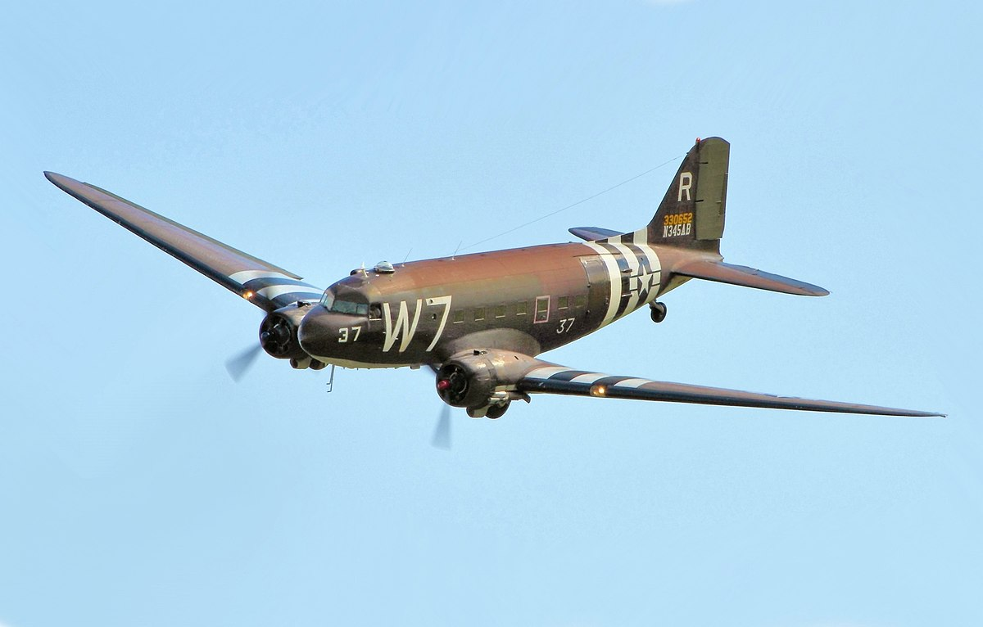

Writing In English, we will be writing poetry designed to entertain, based on the poem The Dreadful Menace. Following this, we will be writing setting descriptions linked to our topic on WWII and then looking at writing letters. | Reading During guided reading sessions, we will encounter a wide variety of texts, answering questions which focus on retrieval, inference, prediction, vocabulary, summarising and explanation. We will also study a class novel on a Monday which is a Michael Morpurgo book called Friend or Foe. | Maths In maths, we will continue to work on addition and subtraction before we move onto multiplication and division. We will work on a variety of fluency, problem solving and reasoning questions. We will also continue to practise times tables. | Science In science, we will be learning all about sound. We will be learning about how sounds are made, what vibrations are, how we can affect pitch and volume, and which materials are most effective at muffling sounds.
Geography/History This term in history, we will be learning all about World War II, beginning with a trip to Metheringham Airfield. We will be looking at how the war began and the impact that it had on Lincolnshire. | Panthers – Years 3/4 Autumn 2 World War II |  | Religious Education We will learn about whether you need to believe in God to be good. We will look at this question from the perspective of different religions. We will learn about how humanists and non-religious people find purpose in their lives as well.
 |  |  | Music In this unit, we ask, ‘How Does Music Connect Us with Our Past?’. The Social Question evolves as the children move through the scheme while encouraging them to be responsible and kind citizens of the world. We will be singing, improvising, composing and performing throughout the unit.
Computing We will be looking at stop frame animation. The children will be creating their own animation using the tablets.
French In French we will be working on our conversational vocabulary to be able to talk about the 4 seasons. | PE Premier Education will be delivering one of our PE sessions each week, where we will be involved in netball. Our other PE session will include dance. | Art and DT Our DT this term will be looking at structures. The children will explore making their own structures for different purposes ensuring they are strong, stable and aesthetically pleasing. The children will explore a range of materials and techniques. | Personal, Social & Health Education Our focus this term is celebrating difference. We will be talking about our families and what makes us all unique and special.

