Slide 1
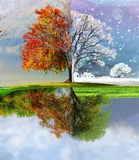
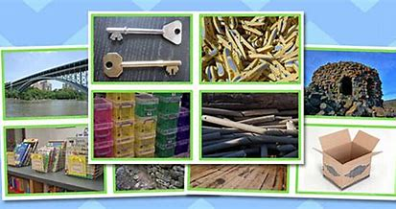
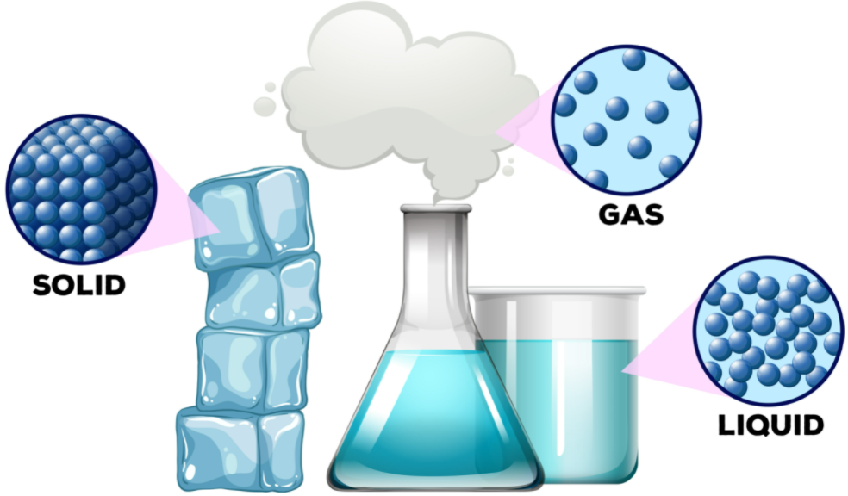
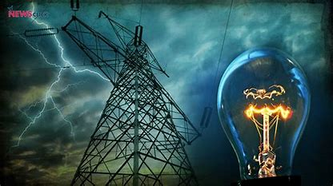
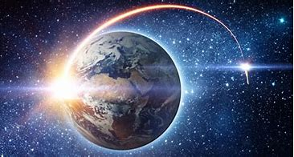
Science Journey Cycle A
Autumn Term (Dunston, Digby & Nocton)
KS1 CURRICULUM
Y1 Unit - Everyday Materials
Y2 Unit - Uses of everyday materials
Y1 Unit - Seasonal Changes
LKS2 CURRICULUM
Y4 Unit – States of matter
UKS2 CURRICULUM
Y5 Unit - Earth and Space
Y6 Unit - Electricity

Slide 2
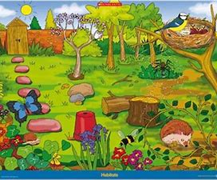
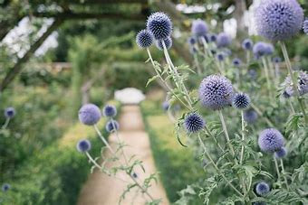
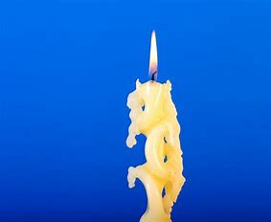
v
Y2 Unit – Living things and
their habitats
Science Journey Cycle A
Spring Term (Dunston, Digby & Nocton)
KS1 CURRICULUM
Y2 Unit – Living things and
their habitats
Y1 Unit - Seasonal Changes
Y1 Unit - Everyday Materials
Y2 Unit - Uses of everyday materials (cont)
LKS2 CURRICULUM
Y4 Unit – Electricity
Y3 Unit - Plants
Y6 Unit - Electricity
UKS2 CURRICULUM
Y5 Unit – Properties and Changes
of Materials

Slide 3
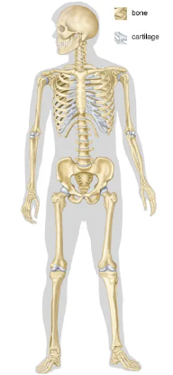
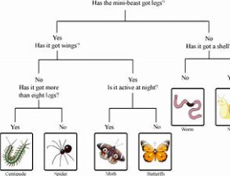
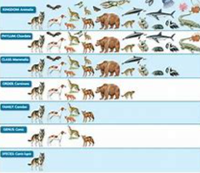
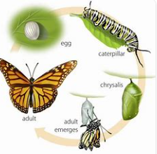
Mini-Investigation - PlantsMini-Investigation - Plants
Mini-Investigation - Plants
Mini-Investigation - Plants
Science Journey Cycle A
Summer Term (Dunston, Digby & Nocton)
KS1 CURRICULUM
Mini topic on plants
Y2 Unit – Living things and
their habitats (cont)
Y1 Unit - Seasonal Changes
LKS2 CURRICULUM
Y3 Unit – Animals including
Humans
Y4 Unit – Living things and their habitats
UKS2 CURRICULUM
Y6 Unit - Livings things
and their habitats
Y5 Unit - Livings things
and their habitats

Slide 4

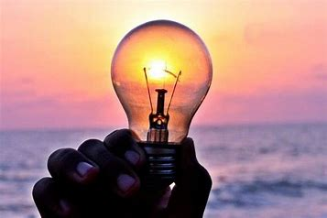
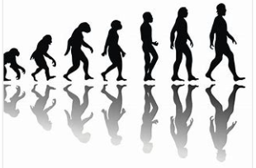

Y4 Unit - Light
Science Journey Cycle B
Autumn Term (Dunston, Digby & Nocton)
KS1 CURRICULUM
Y1 Unit – Animals including humans
Y2 Unit – Animals including humans
Y1 Unit - Seasonal Changes
LKS2 CURRICULUM
Y6 Unit - Light
Y4 Unit - Light
UKS2 CURRICULUM
Y6 Unit – Evolution and Inheritance
Y4 Unit – Sound

Slide 5
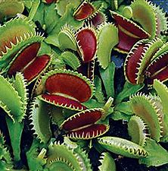
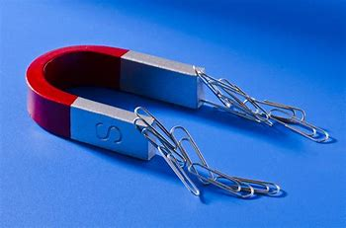


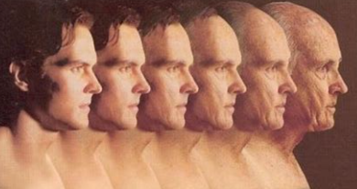
Science Journey Cycle B
Spring Term (Dunston, Digby & Nocton)
KS1 CURRICULUM
Y1 unit – Plants
Y2 unit - Plants
Y1 Unit - Seasonal Changes
Y1 Unit – Animals including humans
Y2 Unit – Animals including humans (cont)
LKS2 CURRICULUM
Y3 Unit – Forces and Magnets
Y3 Unit – Rocks
UKS2 CURRICULUM
Y5 Unit – Animals including humans
Y5 Unit - Forces

Slide 6
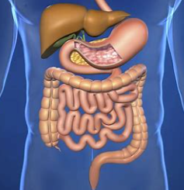
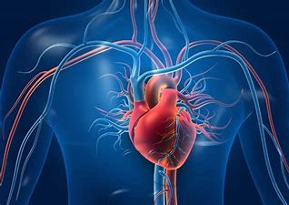
Y6 Unit - Electricity
Science Journey Cycle B
Summer Term (Dunston, Digby & Nocton)
KS1 CURRICULUM
Y1 Unit - Seasonal Changes
Mini Investigation- Materials and
Living things and their habitats
Y1 unit – Plants
Y2 unit - Plants
LKS2 CURRICULUM
Y4 Unit – Animals
Including Humans
UKS2 CURRICULUM
Y6 Unit – Animals
Including humans

