Slide 1

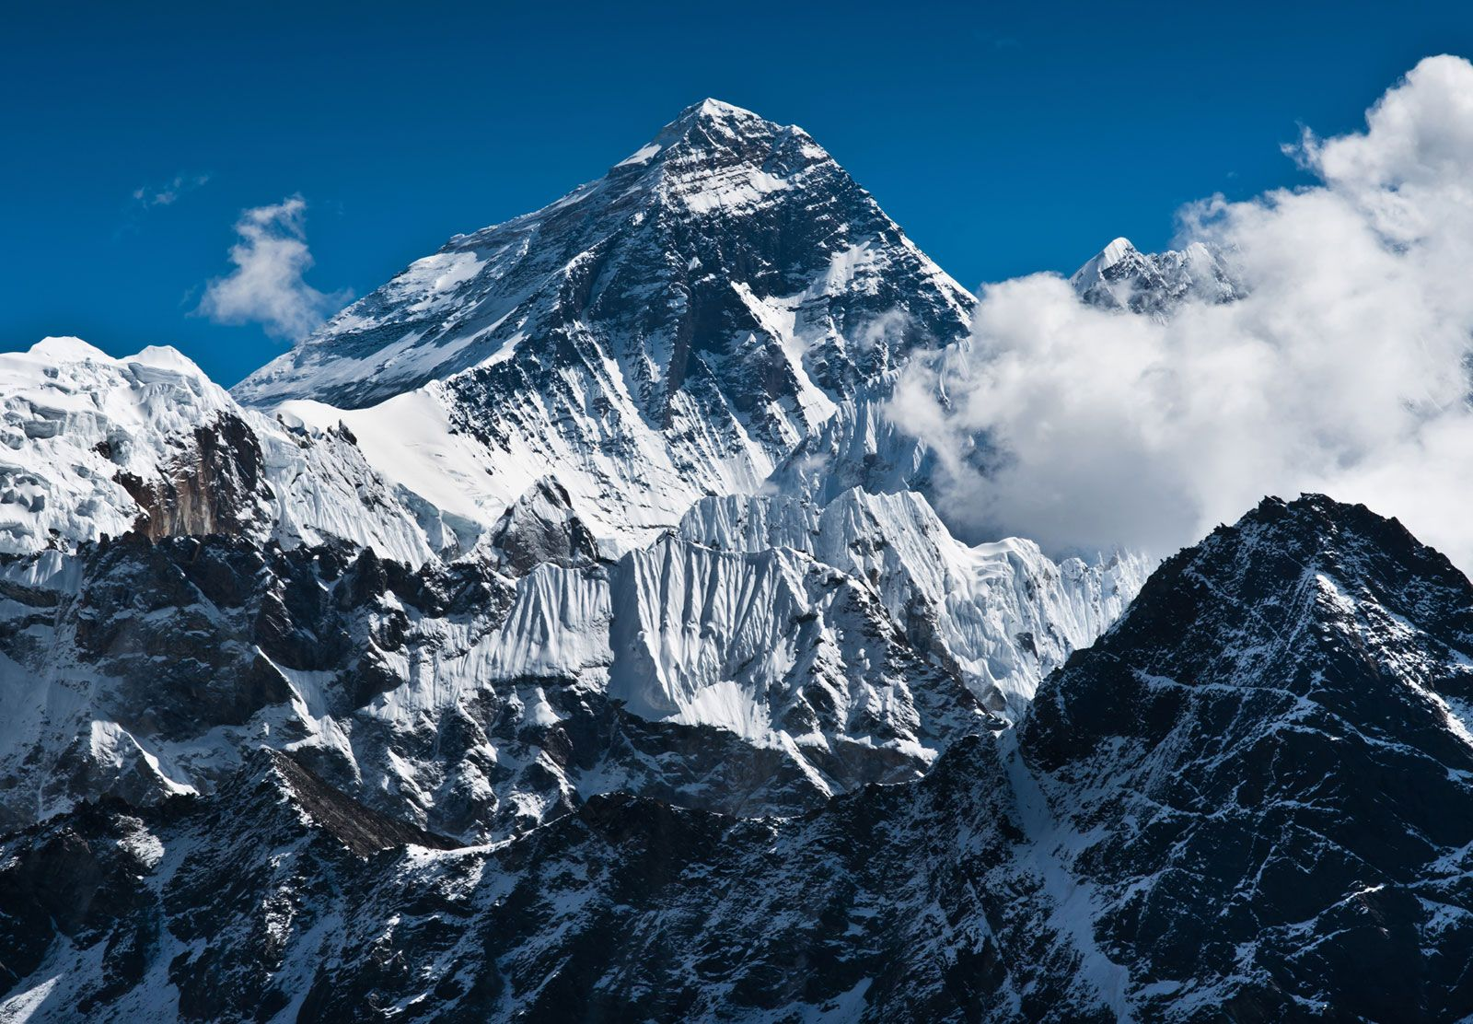
Writing After revisiting many of the underlying literacy skills, we will then start writing a variety of genre types. Our writing will be inspired by our topic of Mountains and our class book: Everest. We will be writing about them in the form of a non-chronological report and a diary entry. | Reading We will read a variety of texts where we answer a range of questions which enables us to critically think and analyse the text: these texts can be found on blogs with resources by Ashley Booth via the internet. We will also have a class book which we will read throughout the term which is the previously mentioned Everest by Alexandre Stewart and Joe Todd-Stanton. | Maths This year, year 5 and 6 children will be learning the same content at the same time as we have now access to mix aged resources. Both will start by learning about place value before they look at 4 different operations. | Personal, Social & Health Education We will be discussing and asking questions around 'being me.' We will think about what our goals are for the year and how we can achieve more together as a community.
Geography/History This term in geography, we will be learning all about mountains. This will involve looking a the science behind them such as how they are formed. We will also look at local geography and weather there are many mountains in the UK before finally looking at mountain climbing and hiking as a hobby (what are the advantages and disadvantages if this). | Imps – Year 5/6 Mountains |  | Religious Education We will learn how people may have different definitions and relationships with God depending on the social background. We will also look at how these stories and ideas of God are depicted through song and art.
 |  |  | Music We will be looking at different songs, singing them, learning to play these songs on a glockenspiel and being able to compose music in the style of the songs learnt.
Computing In computing, we will be looking at research techniques as we attempt to look for relevant and reliable information. This will also include what safe searching is and which search engines are the most effective.
 | PE PE will now be delivered by Premier Education and this term it will be OAA (outdoor adventurous activities). For our other PE lesson, we will be heading to Branston for some swimming sessions; we will learn a variety of strokes and learn water rescue procedures. | Art and DT We will be looking at portraiture in Art. We will use inspiration from the likes of Frida Kahlo, Rembrandt and Grant Wood to create our own portraits and self-portraits. To do this will be learn the differing styles and techniques each use. | Science In science, we will be learning about Light. We will investigate how it travels, how the human eyes sees and look at properties of various materials and whether they let light through or if they might be reflective.
French In French, we will be learning about 'the date'. This will include days of the week and months of the year before we then start to put these words into practise in the form of writing and conversations.

