Slide 1
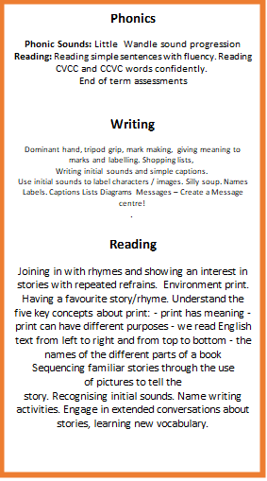
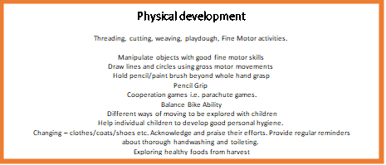
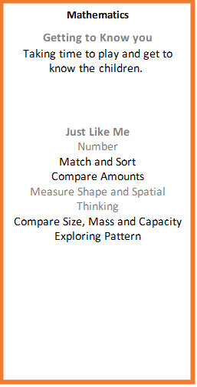

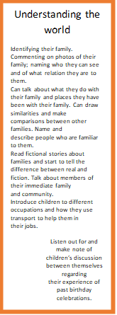

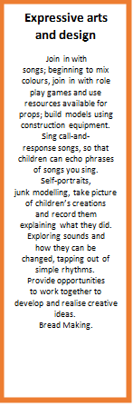
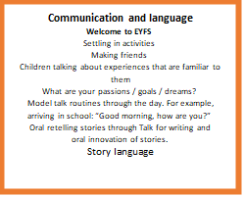
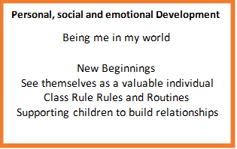
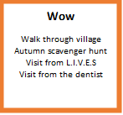
Apples EYFS

Slide 2
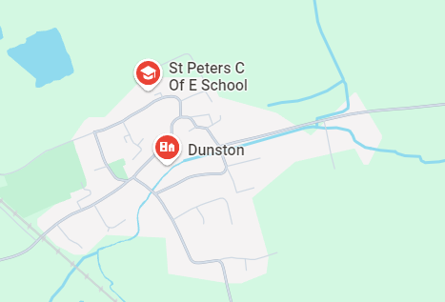

Writing Our writing this term will initially focus on captions, lists and labels where we are using a range of familiar books the children know and love to support writing in this. We are then going to be looking at grammar and punctuation in writing and practicing our handwriting throughout the term. | Reading We will continue to follow the Little Wandle scheme for our Guided Reading sessions. We will also focus on a chapter book as part of our whole-class guided reading, answering lots of different questions. | Maths In maths we are working through our place value unit before moving on to addition and subtraction. We will also be working on problem solving and reasoning questions. | Science In Science we are learning about animals including humans, In our lessons we will be exploring different types of animals and exploring features of animals and what their diets consist of. We will then be moving on to learning about the human body which will include learning about the 5 senses, the parts of the body and how we can look after our body.
Geography Our topic focus this term is Geography, We will be exploring the school grounds and our local area, seeing how these areas support plant growth, How to create a map, how to give directions and learning about the weather in our local area. | Apples–Year 1/2 Autumn 1 On our Doorstep |  | Religious Education What do Christians believe God is like. In this unit, pupils find out what parables are, and that Christians believe these stories were told by Jesus to teach his followers about God. They learn about the parable of the Lost Son and what this story teaches many Christians about God, including God being loving and forgiving. Pupils think carefully about what it means for Christians to ask for forgiveness from God and the promise that people will be welcomed back into God’s family.
Computing This term we are exploring Technology all around us, We are going to be looking at the technology that is available around us, How to use a computer, gaining skills like mouse control, using a keyboard and using a computer responsibly, including how we can keep ourselves safe when we are using technology online.
 |  |  | Music In this unit, we ask, ‘How Does Music Help Us to Understand Our Neighbours?’. The Social Question evolves as the children move through the scheme while encouraging them to be responsible and kind citizens of the world. During this unit the children will sing, improvise, compose, perform, listen and respond as well as learn about the different elements of music.
Personal, Social & Health Education Our focus this term is 'Being me in my world' We will be looking at our hopes and dreams for this year at school, our rules, our rights and responsibilities, rewards and consequences and our learning charter. | PE We have two sessions of PE a week. On a Wednesday the lesson is delivered by Premier Education where they will be focusing on fundamental skills needed in PE, Whilst on a Friday this lesson will focus upon basic skills needed in PE. Some examples of these are running, jumping, rolling, skipping. These lessons may include object control skills such as bouncing, throwing and catching balls. | Art In Art, this term we are looking at portraits and working on our skills of perception and form. Developing our knowledge of colours and shape whilst learning about famous portrait artists.

