Slide 1
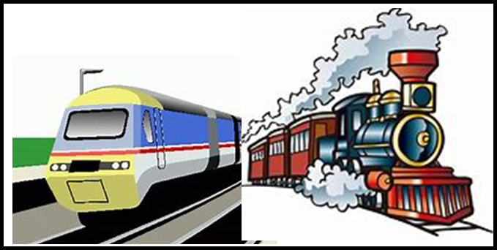
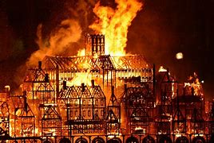
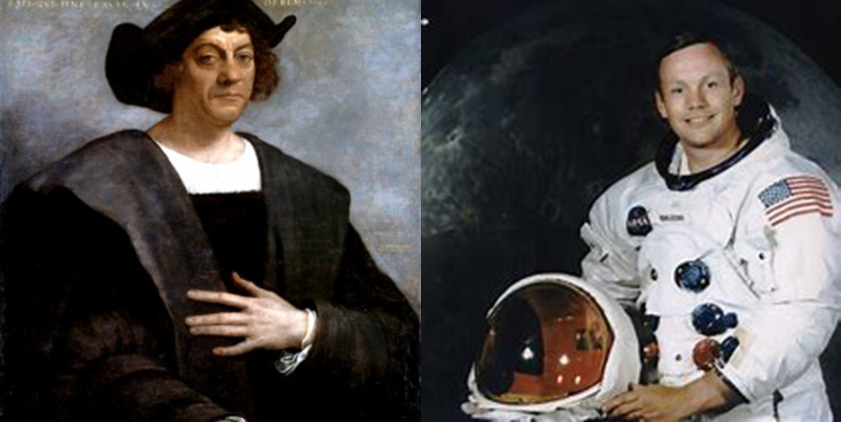
KS1 History Journey Cycle A
AUTUMN
Travel and Transport
SPRING
The Great Fire of London
SUMMER
Intrepid Explorers

Slide 2
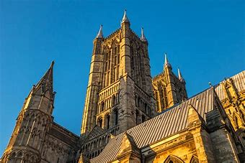
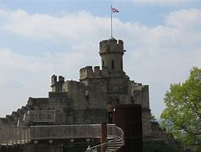
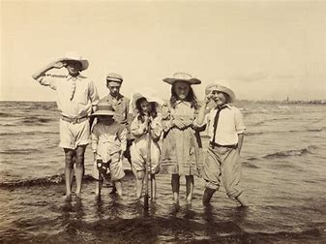
KS1 History Journey Cycle B
AUTUMN
Local History
SPRING
Castles and Monarchs
SUMMER
I do love to be beside the seaside

Slide 3
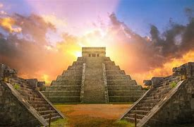
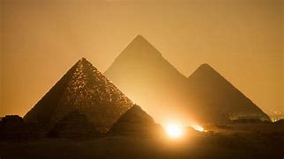
KS2 History Journey Cycle A
Autumn
The Mayans
KS2 CURRICULUM
Summer
Ancient Egypt

Slide 4
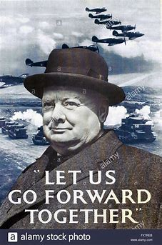

KS2 History Journey Cycle B
Autumn
Lest we forget – WW2
KS2 CURRICULUM
Summer
Ancient Greece

Slide 5
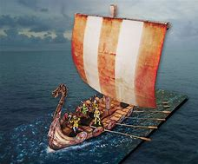
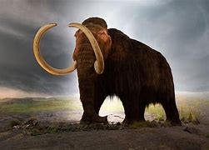
KS2 History Journey Cycle C
Autumn
The Vikings
KS2 CURRICULUM
Summer
The Stone Age

Slide 6

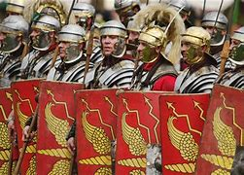
KS2 History Journey Cycle D
Autumn
Crime and Punishment
KS2 CURRICULUM
Summer
The Romans

