Slide 1

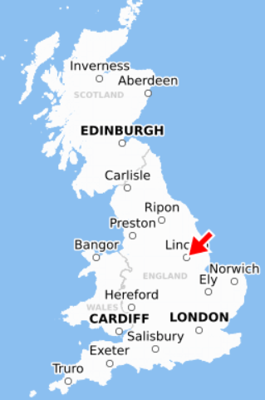
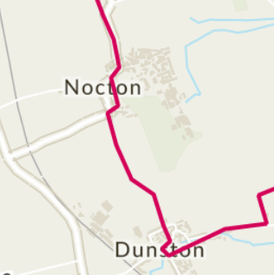
Geography
Cycle A and B
Key Stage 1 Curriculum
Global
Beside the seaside
Locational Knowledge
Geographical skills and fieldwork
Human and Physical Geography
National
Castles and Monarchs
Human and Physical Geography
Local
On your Doorstep
Locational Knowledge
Geographical skills and fieldwork
Global
Terrific Travel
Locational and Place Knowledge
National
Let’s Explore London
Locational and Place Knowledge
Local
Terrific Travel
Locational Knowledge Geographical skills and fieldwork

Slide 2
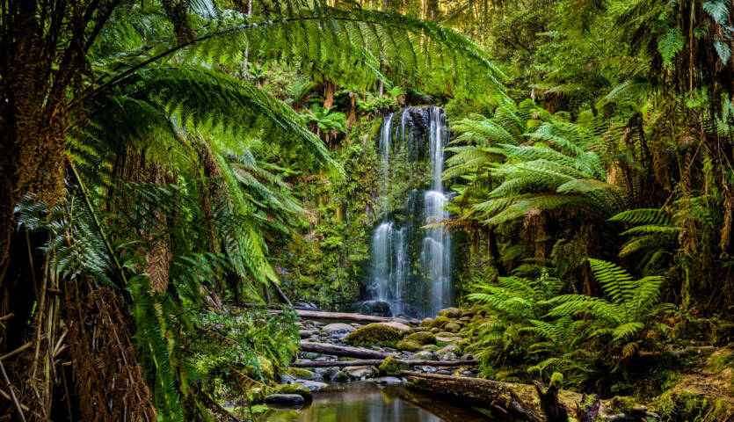
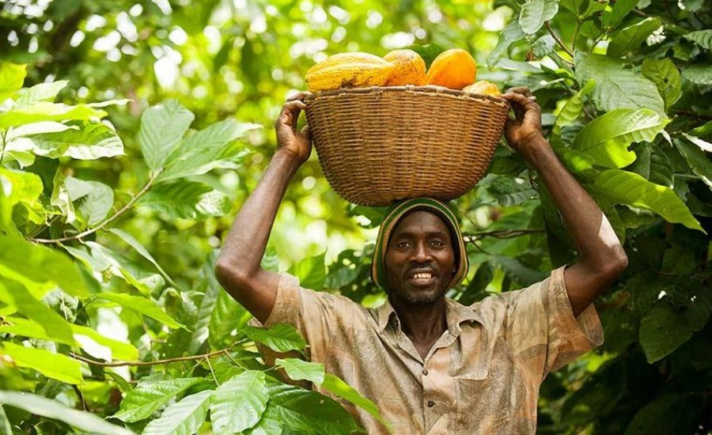
Geography Journey Cycle A
KS2 CURRICULUM
South America
Rainforests
KS2 CURRICULUM
Trade Links
KS2 CURRICULUM

Slide 3
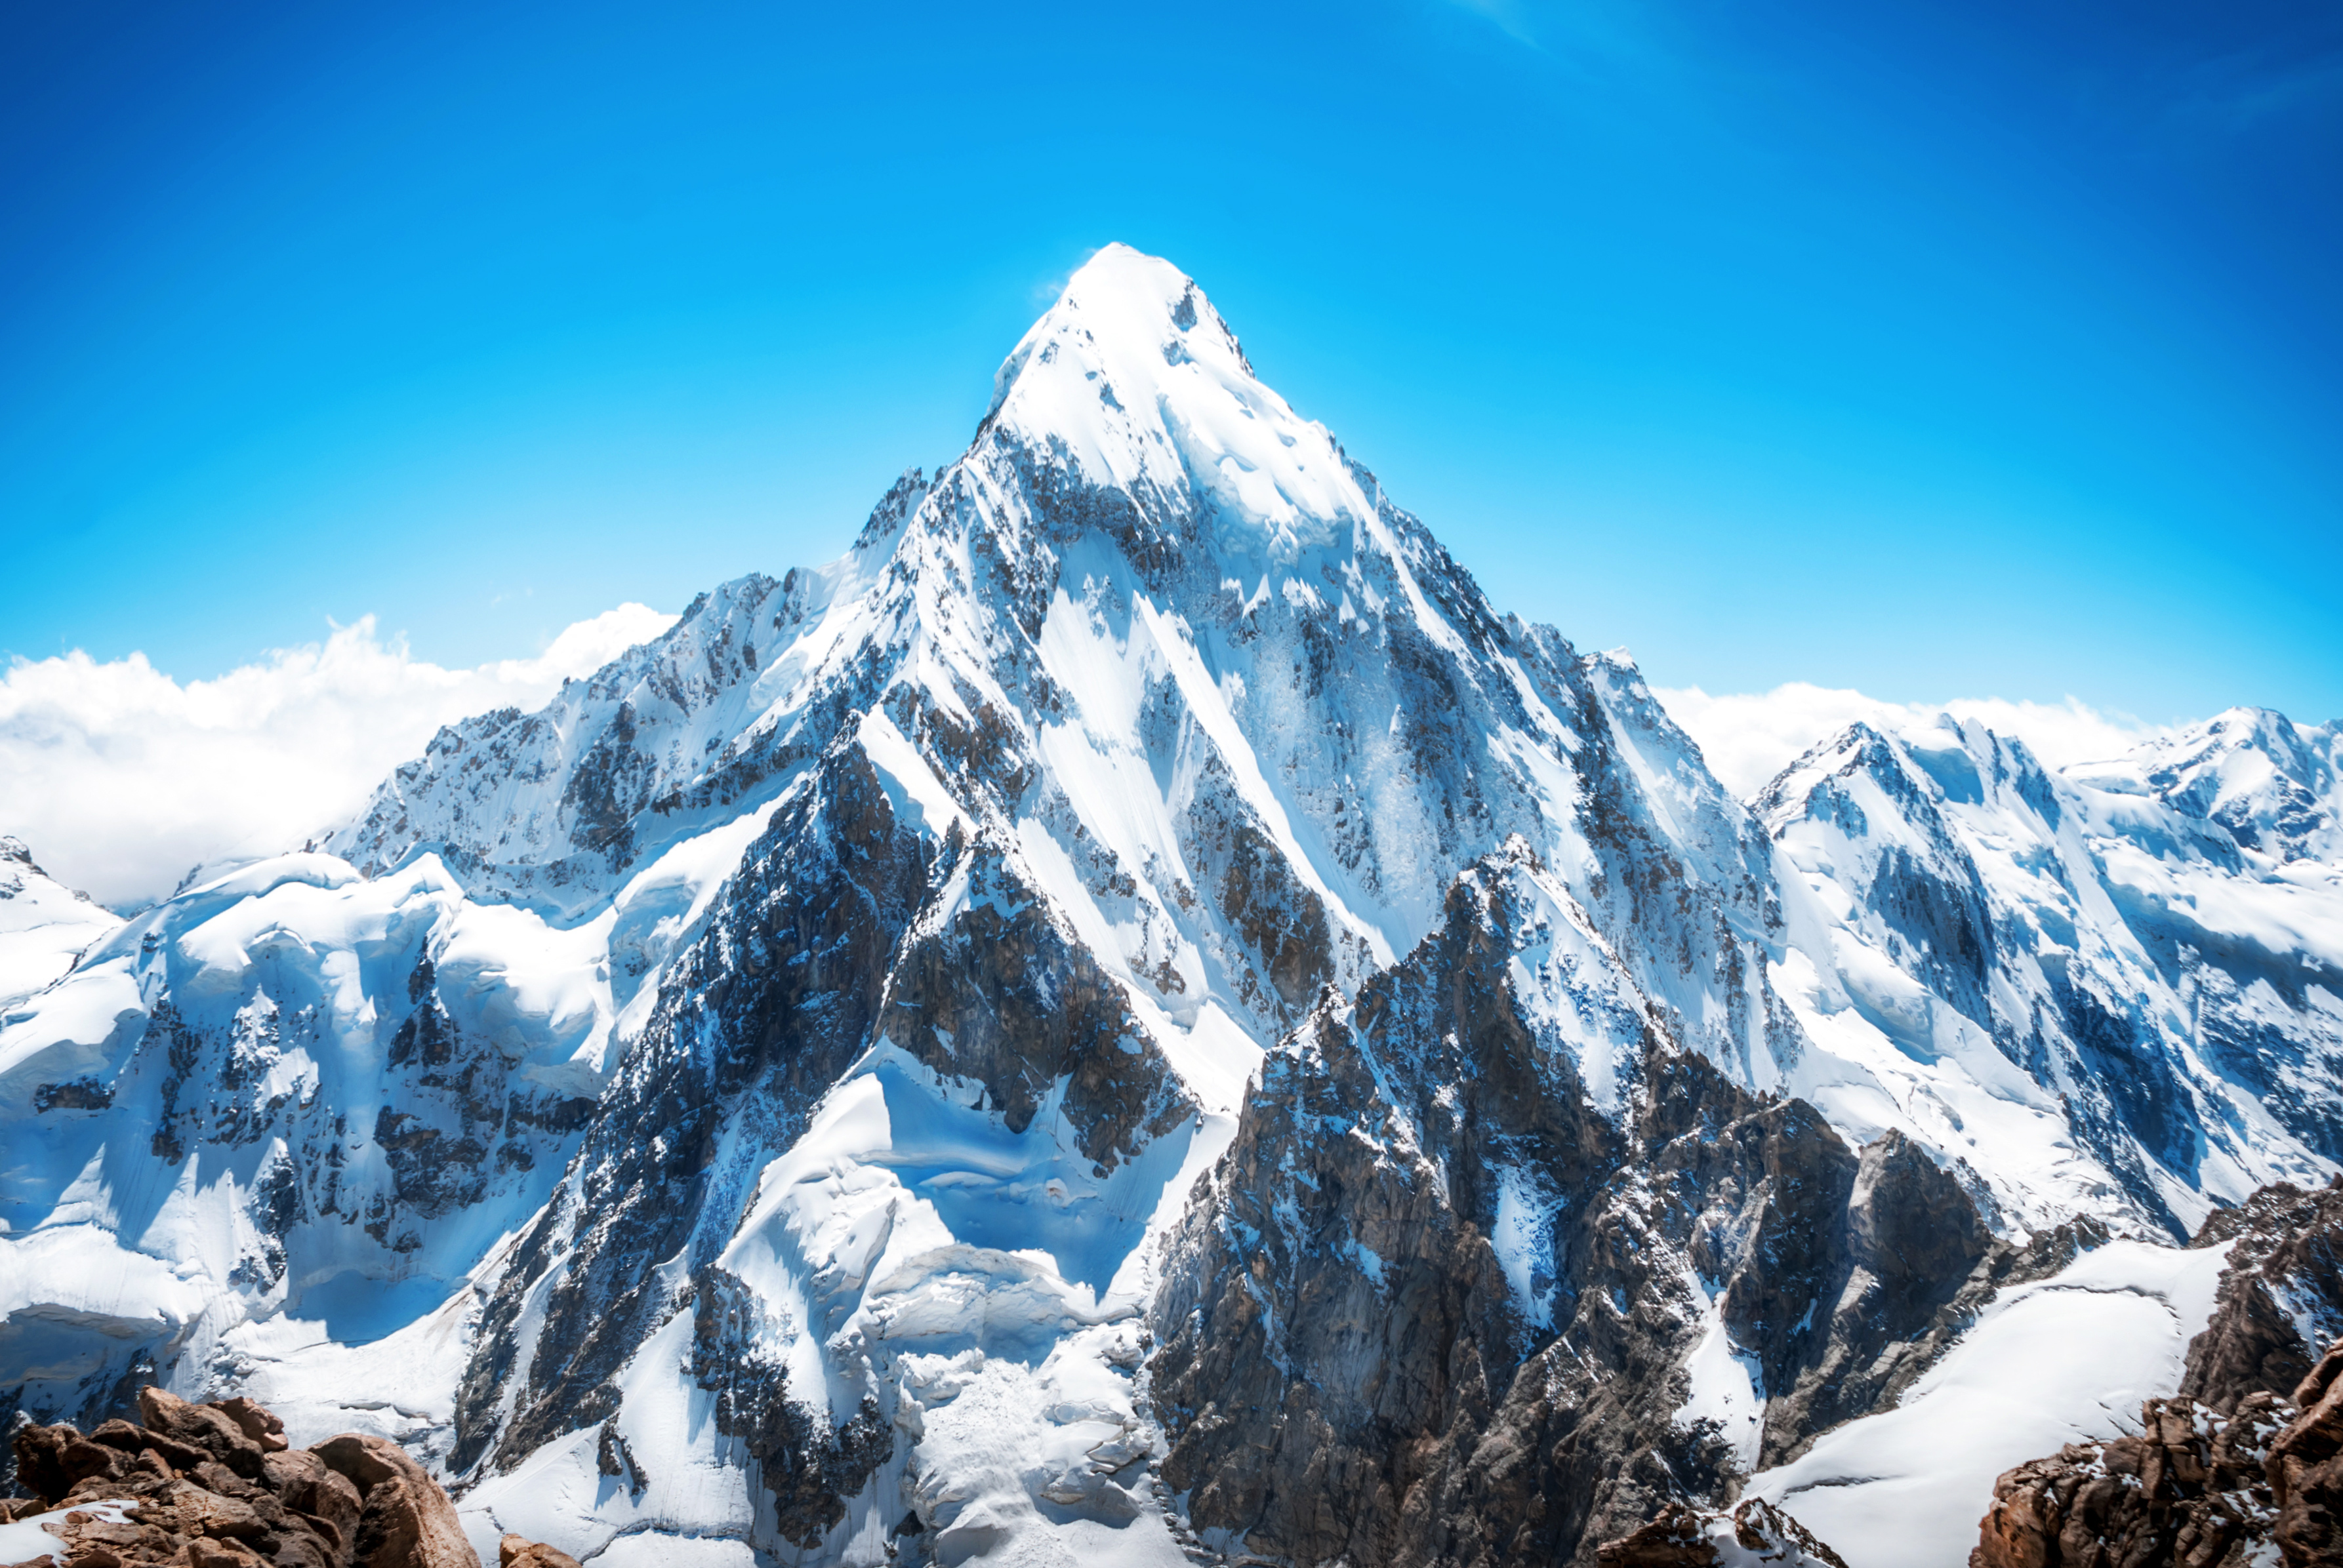
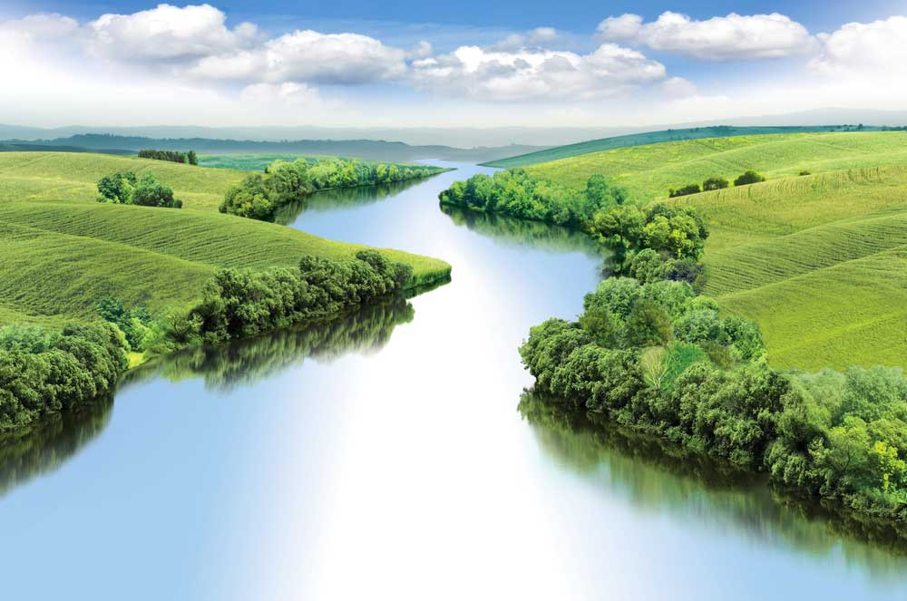
Geography Journey Cycle B
KS2 CURRICULUM
Mountains
KS2 CURRICULUM
Rivers
KS2 CURRICULUM

Slide 4
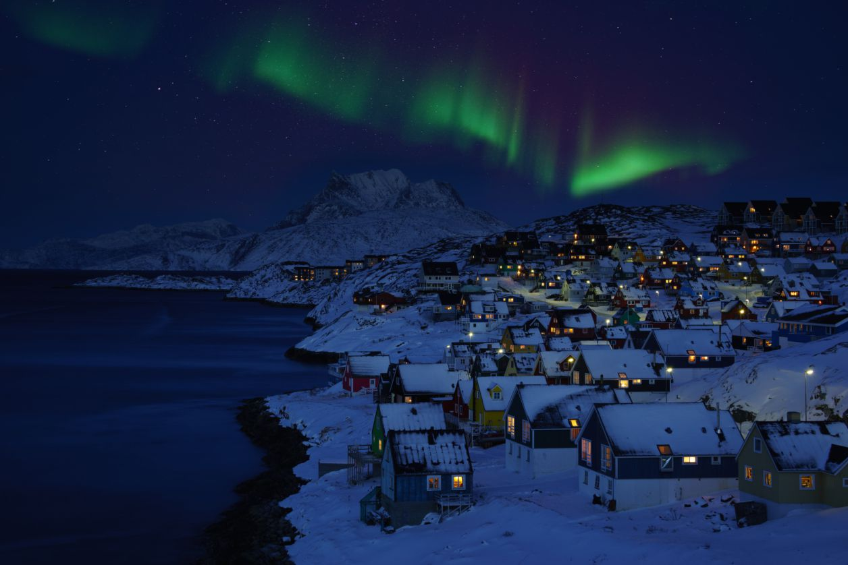
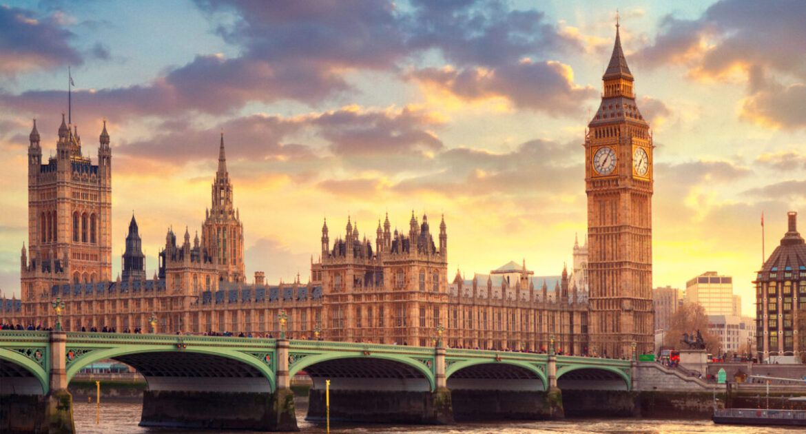
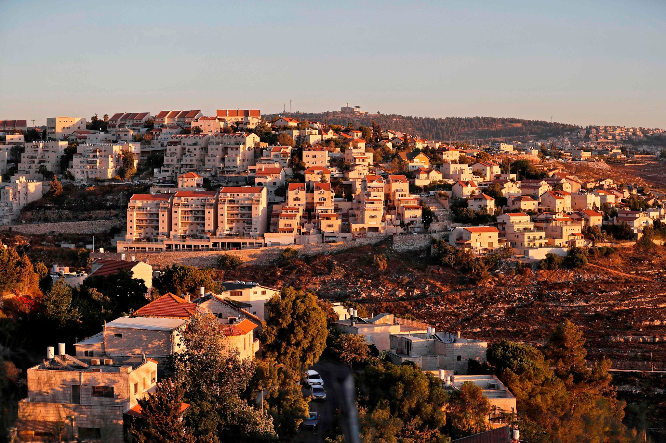
Geography Journey Cycle C
KS2 CURRICULUM
Scandanavia
The UK
KS2 CURRICULUM
KS2 CURRICULUM
Settlements and
Land Use

Slide 5
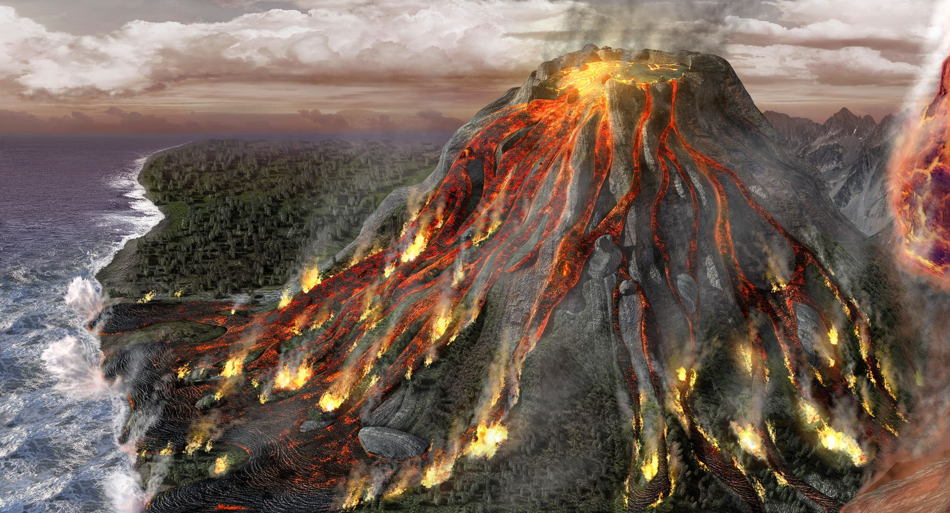
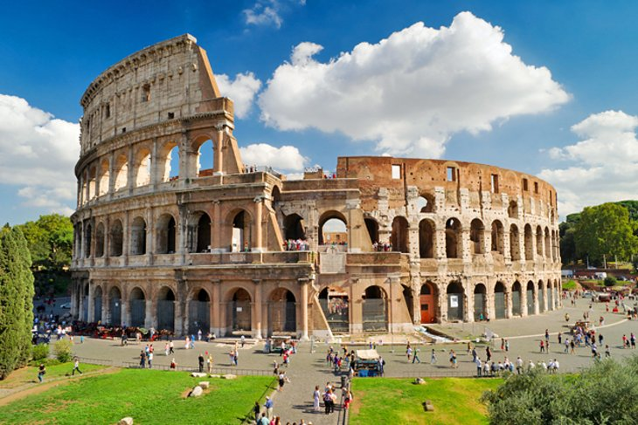
Geography Journey Cycle D
KS2 CURRICULUM
Extreme Earth
KS2 CURRICULUM
European
Study (Italy)
KS2 CURRICULUM

