Slide 1


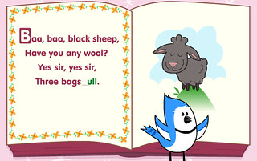
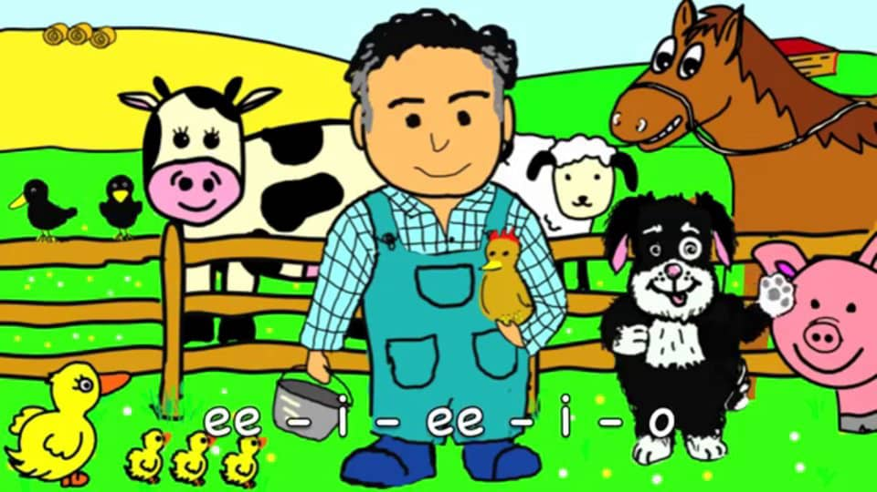

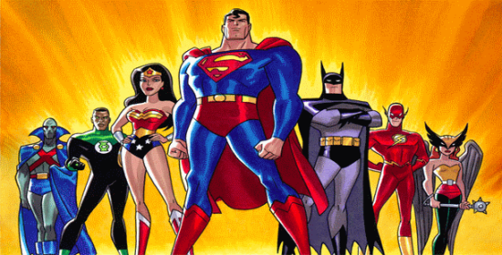
Early Years Journey
EYFS CURRICULUM
All About Me
Once Upon A Time
Autumn 1
Autumn 2
On the farm
Rhyme Time
Spring 2
Spring 1
Summer Holidays
Superheroes
Summer 1
Summer 2

